Slide 1
W4111 – Introduction to Databases Lecture 9: Module II (3), NoSQL (3)
© Donald F. Ferguson, 2024

Slide 2

Contents
2 | W4111-02024F-9-Module-II(3)-NoSql(3) © Donald F. Ferguson, 2024

Slide 3
Contents

Slide 4
Module II Reminder
4 | W4111-02024F-9-Module-II(3)-NoSql(3) © Donald F. Ferguson, 2024

Slide 5

Data Management
Previously
Load/save things quickly.
Storage Mgmt. (cont)
Access data quickly.
Today
Find things quickly (cont).
Query processing, e.g. transform
Declarative language to
Procedural, functional, execution control
Database Systems: The Complete Book (2nd Edition) by Hector Garcia-Molina (Author), Jeffrey D. Ullman (Author), Jennifer Widom (Author)

Slide 6
Indexes
6 | W4111-02024F-9-Module-II(3)-NoSql(3) © Donald F. Ferguson, 2024

Slide 7

Reminder
7 | W4111-02024F-9-Module-II(3)-NoSql(3) © Donald F. Ferguson, 2024

Slide 8
Basic Concepts
Indexing mechanisms used to speed up access to desired data.
E.g., author catalog in library
Search Key - attribute to set of attributes used to look up records in a file.
An index file consists of records (called index entries) of the form
Index files are typically much smaller than the original file
Two basic kinds of indices:
Ordered indices: search keys are stored in sorted order
Hash indices: search keys are distributed uniformly across “buckets” using a “hash function”.
search-key
pointer
search-key
pointer
(“c:\”, LBN, offset)
search-key
pointer
search-key
pointer

Slide 9
Index Concepts
Uni=“dff9”
Last_name >= “Ferguson” AND “last_name” <= “Filch”
Index evaluation and selection criteria
Access types supported efficiently. E.g.,
Records with a specified value in the attribute
Records with an attribute value falling in a specified range of values.
Access time
Update performance: insertion time, deletion time
Space overhead
Index concepts
Primary versus secondary
Clustered vs Non-clustered
Dense versus sparse
Ordered vs Unordered
Single level vs multilevel
There are two main types used:
B+ tree
Hash

Slide 10
B+ Tree
10 | W4111-02024F-9-Module-II(3)-NoSql(3) © Donald F. Ferguson, 2024

Slide 11
Example of B⁺-Tree

Slide 12
B⁺-Tree Index Files (Cont.)
A B⁺-tree is a rooted tree satisfying the following properties:
All paths from root to leaf are of the same length
Each node that is not a root or a leaf has between ⎡n/2⎤ and n children.
A leaf node has between ⎡(n–1)/2⎤ and n–1 values
Special cases:
If the root is not a leaf, it has at least 2 children.
If the root is a leaf (that is, there are no other nodes in the tree), it can have between 0 and (n–1) values.

Slide 13
B⁺-Tree Node Structure
Typical node
K_{i} are the search-key values
P_{i} are pointers to children (for non-leaf nodes) or pointers to records or buckets of records (for leaf nodes).
The search-keys in a node are ordered
K₁ < K₂ < K₃ < . . . < K_{n–1}
(Initially assume no duplicate keys, address duplicates later)

Slide 14
Leaf Nodes in B⁺-Trees
Properties of a leaf node:
For i = 1, 2, . . ., n–1, pointer P_{i} points to a file record with search-key value K_{i},
If L_{i}, L_{j} are leaf nodes and i < j, L_{i}’s search-key values are less than or equal to L_{j}’s search-key values
P_{n} points to next leaf node in search-key order

Slide 15
Non-Leaf Nodes in B⁺-Trees
Non leaf nodes form a multi-level sparse index on the leaf nodes. For a non-leaf node with m pointers:
All the search-keys in the subtree to which P₁ points are less than K₁
For 2 ≤ i ≤ n – 1, all the search-keys in the subtree to which P_{i} points have values greater than or equal to K_{i–1} and less than K_{i}
All the search-keys in the subtree to which P_{n} points have values greater than or equal to K_{n–1}
General structure

Slide 16
Example of B⁺-tree
B⁺-tree for instructor file (n = 6)
Leaf nodes must have between 3 and 5 values (⎡(n–1)/2⎤ and n –1, with n = 6).
Non-leaf nodes other than root must have between 3 and 6 children (⎡(n/2⎤ and n with n =6).
Root must have at least 2 children.

Slide 17
Observations about B⁺-trees
Since the inter-node connections are done by pointers, “logically” close blocks need not be “physically” close.
The non-leaf levels of the B⁺-tree form a hierarchy of sparse indices.
The B⁺-tree contains a relatively small number of levels
Level below root has at least 2* ⎡n/2⎤ values
Next level has at least 2* ⎡n/2⎤ * ⎡n/2⎤ values
.. etc.
If there are K search-key values in the file, the tree height is no more than ⎡ log_{⎡n/2⎤}(K)⎤
thus searches can be conducted efficiently.
Insertions and deletions to the main file can be handled efficiently, as the index can be restructured in logarithmic time (as we shall see).

Slide 18
Show the Simulator
https://www.cs.usfca.edu/~galles/visualization/BPlusTree.html

Slide 19
Hash
19 | W4111-02024F-9-Module-II(3)-NoSql(3) © Donald F. Ferguson, 2024

Slide 20
Static Hashing
A bucket is a unit of storage containing one or more entries (a bucket is typically a disk block).
we obtain the bucket of an entry from its search-key value using a hash function
Hash function h is a function from the set of all search-key values K to the set of all bucket addresses B.
Hash function is used to locate entries for access, insertion as well as deletion.
Entries with different search-key values may be mapped to the same bucket; thus entire bucket has to be searched sequentially to locate an entry.
In a hash index, buckets store entries with pointers to records
In a hash file-organization buckets store records

Slide 21
Handling of Bucket Overflows (Cont.)
Overflow chaining – the overflow buckets of a given bucket are chained together in a linked list.
Above scheme is called closed addressing (also called closed hashing or open hashing depending on the book you use)
An alternative, called open addressing (also called open hashing or closed hashing depending on the book you use) which does not use over- flow buckets, is not suitable for database applications.

Slide 22
Example of Hash File Organization
Hash file organization of instructor file, using dept_name as key.

Slide 23
Deficiencies of Static Hashing
In static hashing, function h maps search-key values to a fixed set of B of bucket addresses. Databases grow or shrink with time.
If initial number of buckets is too small, and file grows, performance will degrade due to too much overflows.
If space is allocated for anticipated growth, a significant amount of space will be wasted initially (and buckets will be underfull).
If database shrinks, again space will be wasted.
One solution: periodic re-organization of the file with a new hash function
Expensive, disrupts normal operations
Better solution: allow the number of buckets to be modified dynamically.

Slide 24
Show the Simulator
http://iswsa.acm.org/mphf/openDSAPerfectHashAnimation/perfectHashAV.html
https://opendsa-server.cs.vt.edu/ODSA/AV/Development/hashAV.html

Slide 25
Query Processing
25 | W4111-02024F-9-Module-II(3)-NoSql(3) © Donald F. Ferguson, 2024

Slide 26
Overview
26 | W4111-02024F-9-Module-II(3)-NoSql(3) © Donald F. Ferguson, 2024

Slide 27
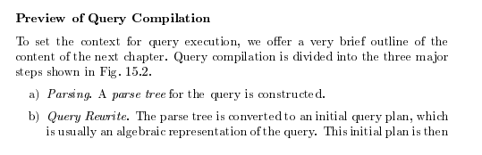
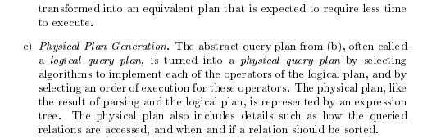
Query Compilation
Database Systems: The Complete Book (2nd Edition) 2nd Edition
by Hector Garcia-Molina (Author), Jeffrey D. Ullman (Author), Jennifer Widom (Author)

Slide 28
Basic Steps in Query Processing
1. Parsing and translation
2. Optimization
3. Evaluation

Slide 29
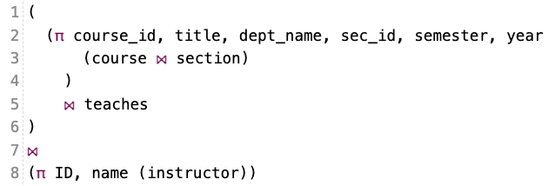
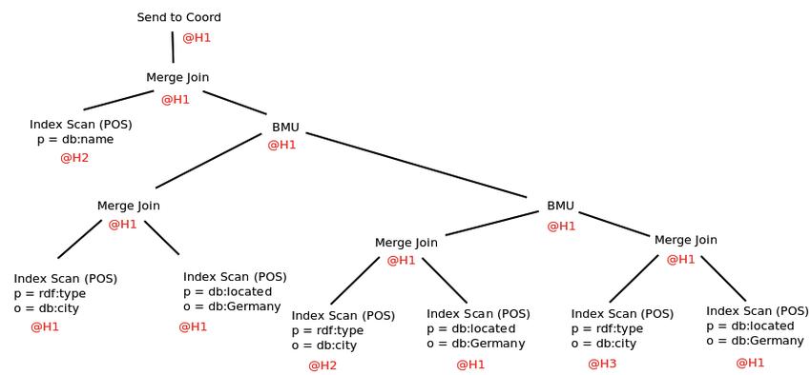
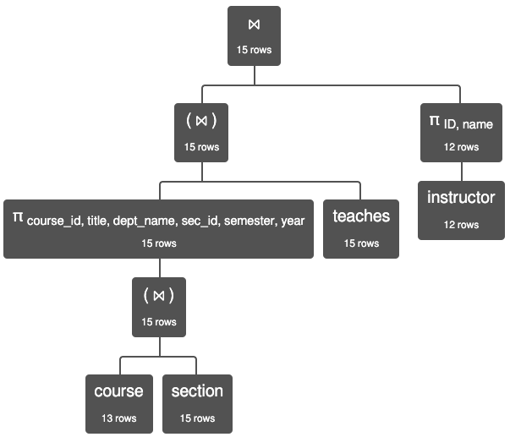
Query Processing
SELECT {SA1, SA2, …..} PROJECT {PA1, PA2, …}
JOIN UNION
DISTINCT

Slide 30
Parsing and Execution
Parser/Translator
Verifies syntax correctness and generates a parse tree.
Converts to logical plan tree that defines how to execute the query.
Tree nodes are operator(tables, parameters)
Edges are the flow of data “up the tree” from node to node.
Optimizer
Modifies the logical plan to define an improved execution.
Query rewrite/transformation.
Determines how to choose among multiple implementations of operators.
Engine
Executes the plan
May modify the plan to optimize execution, e.g. using indexes.

Slide 31
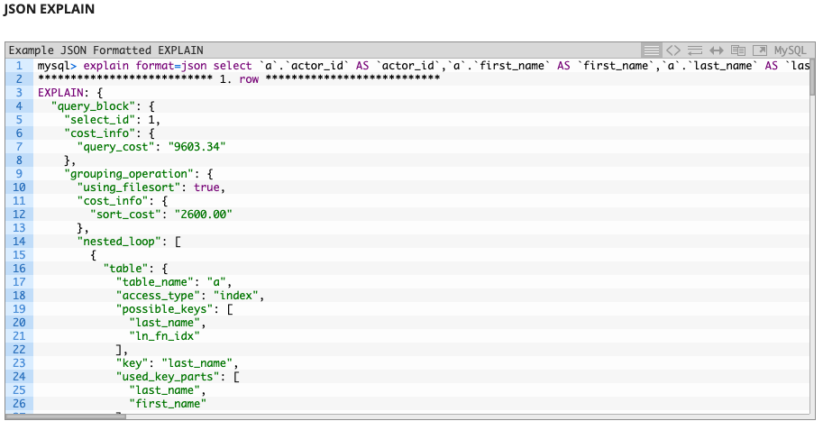
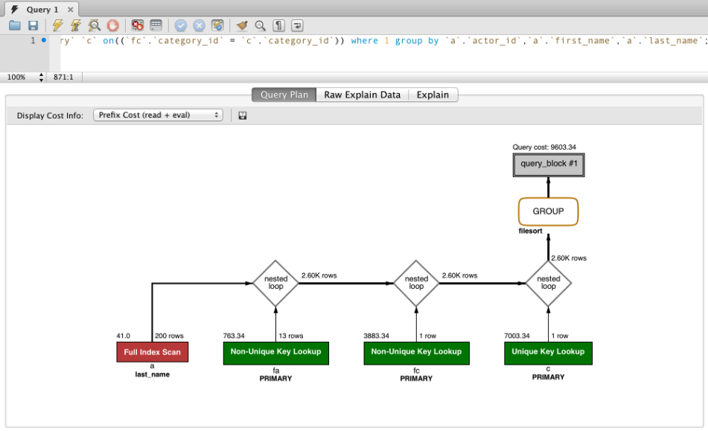
EXPLAIN Example

Slide 32
Basic Steps in Query Processing (Cont.)
Parsing and translation
translate the query into its internal form. This is then translated into relational algebra.
Parser checks syntax, verifies relations
Evaluation
The query-execution engine takes a query-evaluation plan, executes that plan, and returns the answers to the query.

Slide 33
Basic Steps in Query Processing: Optimization
A relational algebra expression may have many equivalent expressions
E.g., σ_{salary<75000}(∏_{salary}(instructor)) is equivalent to ∏_{salary}(σ_{salary<75000}(instructor))
Each relational algebra operation can be evaluated using one of several different algorithms
Correspondingly, a relational-algebra expression can be evaluated in many ways.
Annotated expression specifying detailed evaluation strategy is called an evaluation-plan. E.g.,:
Use an index on salary to find instructors with salary < 75000,
Or perform complete relation scan and discard instructors with salary ≥ 75000

Slide 34
Basic Steps: Optimization (Cont.)
Query Optimization: Amongst all equivalent evaluation plans choose the one with lowest cost.
Cost is estimated using statistical information from the database catalog
e.g.. number of tuples in each relation, size of tuples, etc.
In this chapter we study
How to measure query costs
Algorithms for evaluating relational algebra operations
How to combine algorithms for individual operations in order to evaluate a complete expression
In Chapter 16
We study how to optimize queries, that is, how to find an evaluation plan with lowest estimated cost
Today’s Topics
Next Lecture

Slide 35
Query Cost
35 | W4111-02024F-9-Module-II(3)-NoSql(3) © Donald F. Ferguson, 2024

Slide 36
Measures of Query Cost
Many factors contribute to time cost
disk access, CPU, and network communication
Cost can be measured based on
response time, i.e. total elapsed time for answering query, or
total resource consumption
We use total resource consumption as cost metric
Response time harder to estimate, and minimizing resource consumption is a good idea in a shared database
We ignore CPU costs for simplicity
Real systems do take CPU cost into account
Network costs must be considered for parallel systems
We describe how estimate the cost of each operation
We do not include cost to writing output to disk

Slide 37


Slide 38
Measures of Query Cost
Disk cost can be estimated as:
Number of seeks * average-seek-cost
Number of blocks read * average-block-read-cost
Number of blocks written * average-block-write-cost
For simplicity we just use the number of block transfers from disk and the number of seeks as the cost measures
t_{T} – time to transfer one block
Assuming for simplicity that write cost is same as read cost
t_{S} – time for one seek
Cost for b block transfers plus S seeks b * t_{T} + S * t_{S}
t_{S} and t_{T} depend on where data is stored; with 4 KB blocks:
High end magnetic disk: t_{S} = 4 msec and t_{T} =0.1 msec
SSD: t_{S} = 20-90 microsec and t_{T} = 2-10 microsec for 4KB
If I ask a query cost estimation question on a HW or exam, you only need to estimate the number of block transfers.

Slide 39
Measures of Query Cost (Cont.)
Required data may be buffer resident already, avoiding disk I/O
But hard to take into account for cost estimation
Several algorithms can reduce disk IO by using extra buffer space
Amount of real memory available to buffer depends on other concurrent queries and OS processes, known only during execution
Worst case estimates assume that no data is initially in buffer and only the minimum amount of memory needed for the operation is available
But more optimistic estimates are used in practice
Notes:
39

Slide 40
Algorithm Selection
40 | W4111-02024F-9-Module-II(3)-NoSql(3) © Donald F. Ferguson, 2024

Slide 41
Selection Operation
File scan
Algorithm A1 (linear search). Scan each file block and test all records to see whether they satisfy the selection condition.
Cost estimate = b_{r} block transfers + 1 seek
b_{r} denotes number of blocks containing records from relation r
If selection is on a key attribute, can stop on finding record
cost = (b_{r} /2) block transfers + 1 seek
Linear search can be applied regardless of
selection condition or
ordering of records in the file, or
availability of indices
Note: binary search generally does not make sense since data is not stored consecutively
except when there is an index available,
and binary search requires more seeks than index search

Slide 42
Selections Using Indices
Index scan – search algorithms that use an index
selection condition must be on search-key of index.
A2 (clustering index, equality on key). Retrieve a single record that satisfies the corresponding equality condition
Cost = (h_{i} + 1) * (t_{T} + t_{S})
A3 (clustering index, equality on nonkey) Retrieve multiple records.
Records will be on consecutive blocks
Let b = number of blocks containing matching records
Cost = h_{i} * (t_{T} + t_{S}) + t_{S} + t_{T} * b

Slide 43
Selections Using Indices
A4 (secondary index, equality on key/non-key).
Retrieve a single record if the search-key is a candidate key
Cost = (h_{i} + 1) * (t_{T} + t_{S})
Retrieve multiple records if search-key is not a candidate key
each of n matching records may be on a different block
Cost = (h_{i} + n) * (t_{T} + t_{S})
Can be very expensive!
Notes:
43

Slide 44
Selections Involving Comparisons
Can implement selections of the form σ_{A≤V} (r) or σ_{A ≥ V}(r) by using
a linear file scan,
or by using indices in the following ways:
A5 (clustering index, comparison). (Relation is sorted on A)
For σ_{A ≥ V}(r) use index to find first tuple ≥ v and scan relation sequentially from there
For σ_{A≤V} (r) just scan relation sequentially till first tuple > v; do not use index
A6 (clustering index, comparison).
For σ_{A ≥ V}(r) use index to find first index entry ≥ v and scan index sequentially from there, to find pointers to records.
For σ_{A≤V} (r) just scan leaf pages of index finding pointers to records, till first entry > v
In either case, retrieve records that are pointed to
requires an I/O per record; Linear file scan may be cheaper!

Slide 45
Implementation of Complex Selections
Conjunction: σ_{θ1}∧ _{θ2}∧. . . _{θn}(r)
A7 (conjunctive selection using one index).
Select a combination of θ_{i} and algorithms A1 through A7 that results in the least cost for σ_{θi} (r).
Test other conditions on tuple after fetching it into memory buffer.
A8 (conjunctive selection using composite index).
Use appropriate composite (multiple-key) index if available.
A9 (conjunctive selection by intersection of identifiers).
Requires indices with record pointers.
Use corresponding index for each condition, and take intersection of all the obtained sets of record pointers.
Then fetch records from file
If some conditions do not have appropriate indices, apply test in memory.

Slide 46
Algorithms for Complex Selections
Disjunction:σ_{θ1}∨ _{θ2} ∨. . . _{θn} (r).
A10 (disjunctive selection by union of identifiers).
Applicable if all conditions have available indices.
Otherwise use linear scan.
Use corresponding index for each condition, and take union of all the obtained sets of record pointers.
Then fetch records from file
Negation: σ_{¬θ}(r)
Use linear scan on file
If very few records satisfy ¬θ, and an index is applicable to θ
Find satisfying records using index and fetch from file

Slide 47
Index Creation
Sorting and Hash
47 | W4111-02024F-9-Module-II(3)-NoSql(3) © Donald F. Ferguson, 2024

Slide 48
Sorting
We may build an index on the relation, and then use the index to read the relation in sorted order. May lead to one disk block access for each tuple.
For relations that fit in memory, techniques like quicksort can be used.
For relations that don’t fit in memory, external sort-merge is a good choice.
The engine may build either a sorted index or a hash index.
The key idea is:
The cost of building the index and then using the index in the algorithm
Is cheaper than running the default algorithm with an index

Slide 49
JOIN
49 | W4111-02024F-9-Module-II(3)-NoSql(3) © Donald F. Ferguson, 2024

Slide 50
Join Operation
Several different algorithms to implement joins
Nested-loop join
Block nested-loop join
Indexed nested-loop join
Merge-join
Hash-join
Choice based on cost estimate
Examples use the following information
Number of records of student: 5,000 takes: 10,000
Number of blocks of student: 100 takes: 400

Slide 51
Nested-Loop Join
To compute the theta join r ⨝ _{θ} s for each tuple t_{r} in r do begin for each tuple t_{s} in s do begin test pair (t_{r},t_{s}) to see if they satisfy the join condition θ if they do, add t_{r} • t_{s} to the result. end end
r is called the outer relation and s the inner relation of the join.
Requires no indices and can be used with any kind of join condition.
Expensive since it examines every pair of tuples in the two relations.
For clarity (or confusion), I sometimes use the terms:
Scan table for the outer relation
Probe table for the inner relation

Slide 52
Nested-Loop Join (Cont.)
In the worst case, if there is enough memory only to hold one block of each relation, the estimated cost is n_{r} ∗ b_{s} + b_{r} block transfers, plus n_{r} + b_{r} seeks
If the smaller relation fits entirely in memory, use that as the inner relation.
Reduces cost to b_{r} + b_{s} block transfers and 2 seeks
Assuming worst case memory availability cost estimate is
with student as outer relation:
5000 ∗ 400 + 100 = 2,000,100 block transfers,
5000 + 100 = 5100 seeks
with takes as the outer relation
10000 ∗ 100 + 400 = 1,000,400 block transfers and 10,400 seeks
If smaller relation (student) fits entirely in memory, the cost estimate will be 500 block transfers.
Block nested-loops algorithm (next slide) is preferable.

Slide 53
Indexed Nested-Loop Join
Index lookups can replace file scans if
join is an equi-join or natural join and
an index is available on the inner relation’s join attribute
Can construct an index just to compute a join.
For each tuple t_{r} in the outer relation r, use the index to look up tuples in s that satisfy the join condition with tuple t_{r}.
Worst case: buffer has space for only one page of r, and, for each tuple in r, we perform an index lookup on s.
Cost of the join: b_{r} (t_{T} + t_{S}) + n_{r} ∗ c
Where c is the cost of traversing index and fetching all matching s tuples for one tuple or r
c can be estimated as cost of a single selection on s using the join condition.
If indices are available on join attributes of both r and s, use the relation with fewer tuples as the outer relation.

Slide 54
Merge-Join
1. Sort both relations on their join attribute (if not already sorted on the join
attributes).
2. Merge the sorted relations to join them
1. Join step is similar to the merge stage of the sort-merge algorithm.
2. Main difference is handling of duplicate values in join attribute —
every pair with same value on join attribute must be matched
3. Detailed algorithm in book
#(A) = n, #(B) = m
n*m
n*log(n) + m*log(m) + n + m

Slide 55
Merge-Join (Cont.)
Can be used only for equi-joins and natural joins
Each block needs to be read only once (assuming all tuples for any given value of the join attributes fit in memory
Thus the cost of merge join is: b_{r} + b_{s} block transfers + ⎡b_{r} / b_{b}⎤ + ⎡b_{s} / b_{b}⎤ seeks
+ the cost of sorting if relations are unsorted.
hybrid merge-join: If one relation is sorted, and the other has a secondary B⁺-tree index on the join attribute
Merge the sorted relation with the leaf entries of the B⁺-tree .
Sort the result on the addresses of the unsorted relation’s tuples
Scan the unsorted relation in physical address order and merge with previous result, to replace addresses by the actual tuples
Sequential scan more efficient than random lookup

Slide 56
Hash-Join
Applicable for equi-joins and natural joins.
A hash function h is used to partition tuples of both relations
h maps JoinAttrs values to {0, 1, ..., n}, where JoinAttrs denotes the common attributes of r and s used in the natural join.
r₀, r₁, . . ., r_{n} denote partitions of r tuples
Each tuple t_{r} ∈ r is put in partition r_{i} where i = h(t_{r} [JoinAttrs]).
r₀,, r₁. . ., r_{n} denotes partitions of s tuples
Each tuple t_{s} ∈s is put in partition s_{i}, where i = h(t_{s} [JoinAttrs]).
Note: In book, Figure 12.10 r_{i} is denoted as H_{ri,} s_{i} is denoted as H_{si} and n is denoted as n_{h.}

Slide 57
Hash-Join (Cont.)
On a.X=b.Z

Slide 58
Hash-Join (Cont.)
r tuples in r_{i} need only to be compared with s tuples in s_{i} Need not be compared with s tuples in any other partition, since:
an r tuple and an s tuple that satisfy the join condition will have the same value for the join attributes.
If that value is hashed to some value i, the r tuple has to be in r_{i} and the s tuple in s_{i}.

Slide 59
Hash-Join Algorithm
The hash-join of r and s is computed as follows.
1. Partition the relation s using hashing function h. When partitioning a relation, one block of memory is reserved as the output buffer for each partition.
2. Partition r similarly.
3. For each i:
(a) Load s_{i} into memory and build an in-memory hash index on it using the join attribute. This hash index uses a different hash function than the earlier one h.
(b) Read the tuples in r_{i} from the disk one by one. For each tuple t_{r} locate each matching tuple t_{s} in s_{i} using the in-memory hash index. Output the concatenation of their attributes.
Relation s is called the build input and r is called the probe input.

Slide 60
Hash-Join algorithm (Cont.)
The value n and the hash function h is chosen such that each s_{i} should fit in memory.
Typically n is chosen as ⎡b_{s}/M⎤ * f where f is a “fudge factor”, typically around 1.2
The probe relation partitions s_{i} need not fit in memory
Recursive partitioning required if number of partitions n is greater than number of pages M of memory.
instead of partitioning n ways, use M – 1 partitions for s
Further partition the M – 1 partitions using a different hash function
Use same partitioning method on r
Rarely required: e.g., with block size of 4 KB, recursive partitioning not needed for relations of < 1GB with memory size of 2MB, or relations of < 36 GB with memory of 12 MB

Slide 61
Other Operations
61 | W4111-02024F-9-Module-II(3)-NoSql(3) © Donald F. Ferguson, 2024

Slide 62
Other Operations
Duplicate elimination can be implemented via hashing or sorting.
On sorting duplicates will come adjacent to each other, and all but one set of duplicates can be deleted.
Optimization: duplicates can be deleted during run generation as well as at intermediate merge steps in external sort-merge.
Hashing is similar – duplicates will come into the same bucket.
Projection:
perform projection on each tuple
followed by duplicate elimination.

Slide 63
Other Operations : Aggregation
Aggregation can be implemented in a manner similar to duplicate elimination.
Sorting or hashing can be used to bring tuples in the same group together, and then the aggregate functions can be applied on each group.
Optimization: partial aggregation
combine tuples in the same group during run generation and intermediate merges, by computing partial aggregate values
For count, min, max, sum: keep aggregate values on tuples found so far in the group.
When combining partial aggregate for count, add up the partial aggregates
For avg, keep sum and count, and divide sum by count at the end

Slide 64
Evaluation of Expressions
So far: we have seen algorithms for individual operations
Alternatives for evaluating an entire expression tree
Materialization: generate results of an expression whose inputs are relations or are already computed, materialize (store) it on disk. Repeat.
Pipelining: pass on tuples to parent operations even as an operation is being executed
We study above alternatives in more detail

Slide 65
Evaluation
65 | W4111-02024F-9-Module-II(3)-NoSql(3) © Donald F. Ferguson, 2024

Slide 66
Materialization
Materialized evaluation: evaluate one operation at a time, starting at the lowest-level. Use intermediate results materialized into temporary relations to evaluate next-level operations.
E.g., in figure below, compute and store then compute the store its join with instructor, and finally compute the projection on name.

Slide 67
Materialization (Cont.)
Materialized evaluation is always applicable
Cost of writing results to disk and reading them back can be quite high
Our cost formulas for operations ignore cost of writing results to disk, so
Overall cost = Sum of costs of individual operations + cost of writing intermediate results to disk
Double buffering: use two output buffers for each operation, when one is full write it to disk while the other is getting filled
Allows overlap of disk writes with computation and reduces execution time

Slide 68
Pipelining
Pipelined evaluation: evaluate several operations simultaneously, passing the results of one operation on to the next.
E.g., in previous expression tree, don’t store result of
instead, pass tuples directly to the join.. Similarly, don’t store result of join, pass tuples directly to projection.
Much cheaper than materialization: no need to store a temporary relation to disk.
Pipelining may not always be possible – e.g., sort, hash-join.
For pipelining to be effective, use evaluation algorithms that generate output tuples even as tuples are received for inputs to the operation.
Pipelines can be executed in two ways: demand driven and producer driven

Slide 69
Pipelining (Cont.)
In demand driven or lazy evaluation
system repeatedly requests next tuple from top level operation
Each operation requests next tuple from children operations as required, in order to output its next tuple
In between calls, operation has to maintain “state” so it knows what to return next
In producer-driven or eager pipelining
Operators produce tuples eagerly and pass them up to their parents
Buffer maintained between operators, child puts tuples in buffer, parent removes tuples from buffer
if buffer is full, child waits till there is space in the buffer, and then generates more tuples
System schedules operations that have space in output buffer and can process more input tuples
Alternative name: pull and push models of pipelining

Slide 70
Pipelining (Cont.)
Implementation of demand-driven pipelining
Each operation is implemented as an iterator implementing the following operations
open()
E.g., file scan: initialize file scan
state: pointer to beginning of file
E.g., merge join: sort relations;
state: pointers to beginning of sorted relations
next()
E.g., for file scan: Output next tuple, and advance and store file pointer
E.g., for merge join: continue with merge from earlier state till next output tuple is found. Save pointers as iterator state.
close()

Slide 71
HW3 and HW4, “The Project” Discussion
71 | W4111-02024F-9-Module-II(3)-NoSql(3) © Donald F. Ferguson, 2024

Slide 72
Overview
72 | W4111-02024F-9-Module-II(3)-NoSql(3) © Donald F. Ferguson, 2024

Slide 73
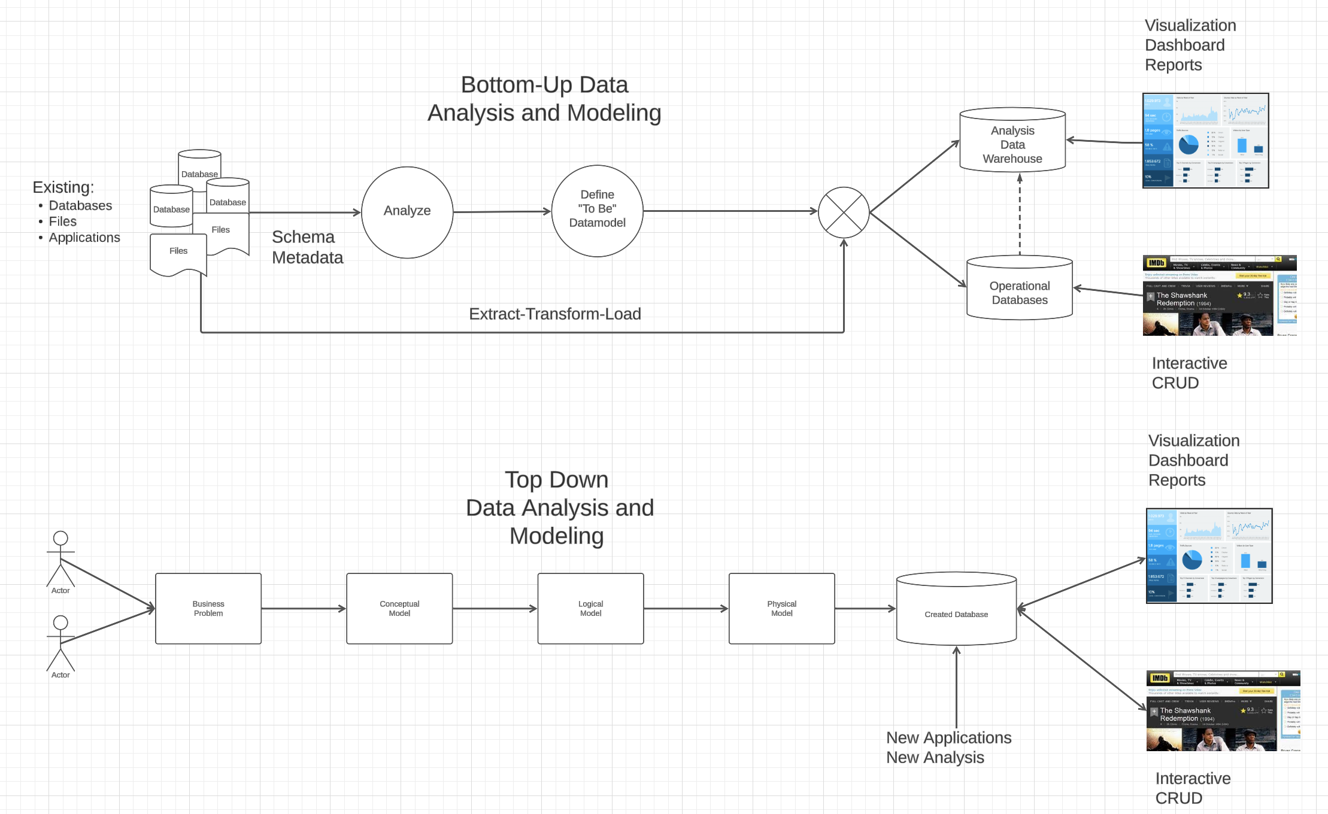
Vision

Slide 74
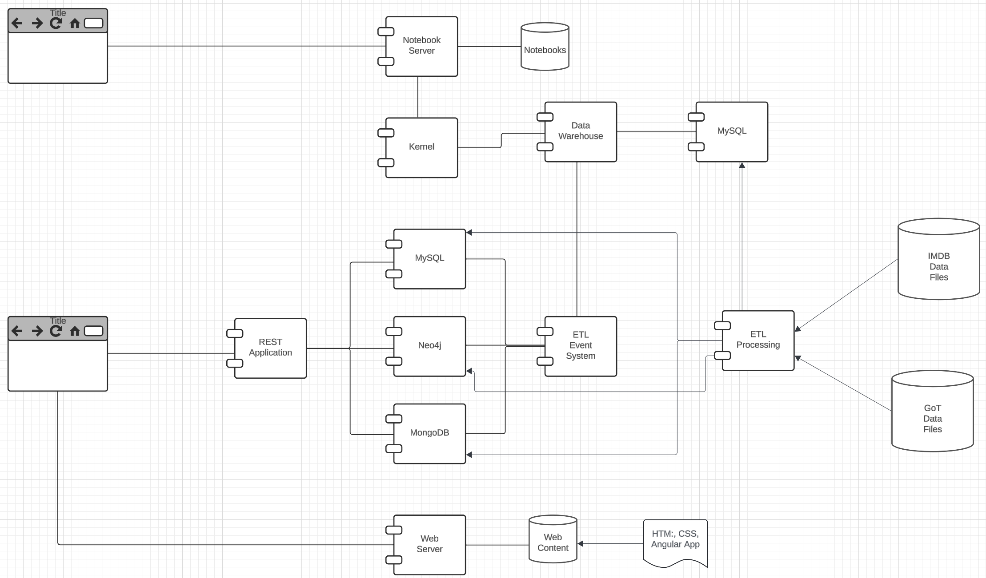
Vision

Slide 75
Vision
Both programming and non-programming implement a data engineering Jupyter notebook.
The programming track builds a simple REST application/microservice for transformed data.
Non-programming implements more complex transformation, and queries for visualization.
I will provide starter projects with examples.

Slide 76
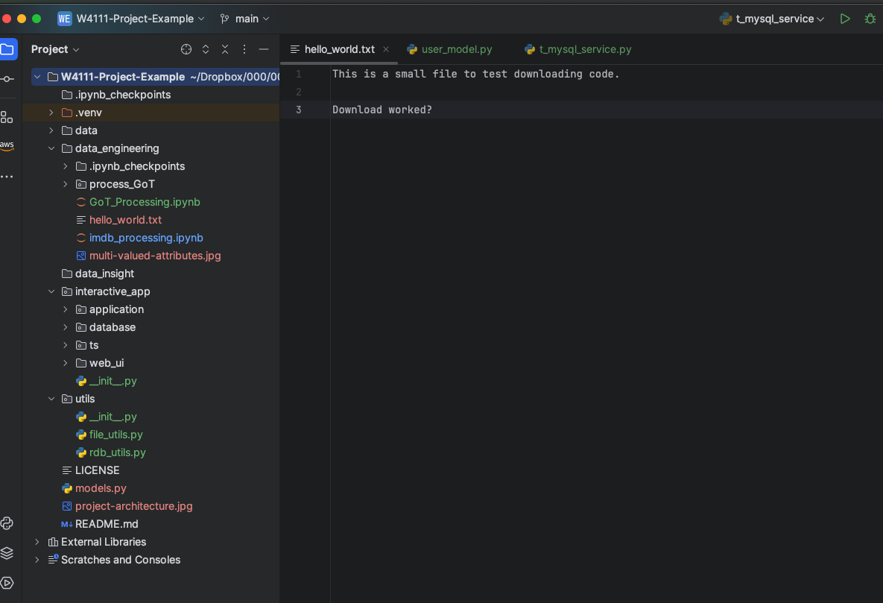
Hw3, HW4 and Project

Slide 77
Hw3, HW4 and Project
Directories for both tracks:
/data contains the input files in CSV and JSON formats
I planned to allow students to choose their own datsets, but this introduces too much complexity. We would have an entire phase of “Is this a goo dataset?”
I will provide simplified IMDB and GoT data.
/data_engineering for initial ETL
/data_insight contains more complex queries and visualization for the non-programming track.
/interactive_application contains a simple web UI, REST application template and database schema for the programming tracks

Slide 78
REST
78 | W4111-02024F-9-Module-II(3)-NoSql(3) © Donald F. Ferguson, 2024

Slide 79
Data Modeling Concepts and REST
Almost any data model has the same core concepts:
Types and instances:
Entity Type: A definition of a type of thing with properties and relationships.
Entity Instance: A specific instantiation of the Entity Type
Entity Set Instance: An Entity Type that:
Has properties and relationships like any entity, but ...
Has at least one special relationship – contains.
Operations, minimally CRUD, that manipulate entity types and instances:
Create
Retrieve
Update
Delete
Reference/Identify/... ...
Host/database/table/pk

Slide 80
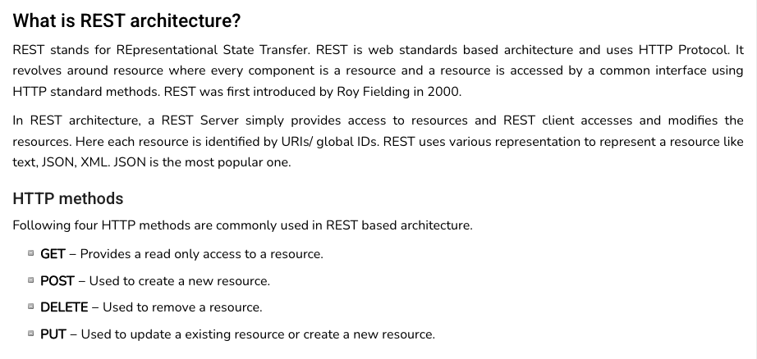
REST (https://www.tutorialspoint.com/restful/restful_introduction.htm)

Slide 81
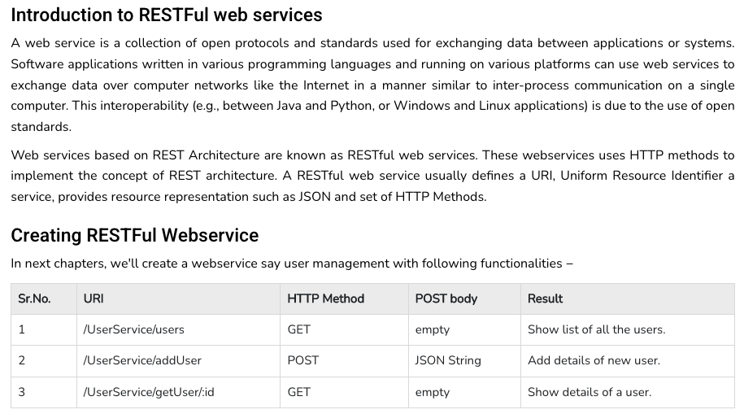
REST (https://www.tutorialspoint.com/restful/restful_introduction.htm)

Slide 82
REST and Resources

Slide 83
URLs

Slide 84
jdbc:mysql://columbia-examples.ckkqqktwkcji.us-east-1.rds.amazonaws.com:3306
GET http://localhost:5001/f23_imdb_clean/name_basics/nm0000158
GET http://localhost:5001/f23_imdb_clean/name_basics?deathYear=2023&birthyear=1960
select * from f23_imdb_clean.name_basics where
deathYear=2023 AND birthyear=1960
PUT http://localhost:5001/f23_imdb_clean/name_basics ?deathYear=2023&birthyear=1960
Body {‘primaryName’: ‘Does not matter cause is dead.’}
update f23_imdb_clean.name_basics
set
where deathYear=2023 AND birthyear=1960

